Slide 1

Chapter 14
Processing JavaScript Object Notation (JSON)

Slide 2
Learning Objectives
JSON provides a format for defining objects.
How to create an object using JSON.
How to create an array of objects using JSON.
How to retrieve a JSON file from a remote server for processing.

Slide 3
Getting started with json
JavaScript, as you have learned, makes extensive use of objects. Using JSON, you can store data in a format that aligns with the JavaScript object format. For example, assume that you have a Student object that has a studentID, name, and GPA field. Using the JSON format, you can represent the fields and values as follows:
Student = {"StudentID" : "12345", "Name" : "Smith", "GPA" : "3.5" };
As you can see, JSON specifies a field name followed by a colon (:), followed by a value. Using JSON, you separate fields using a comma.

Slide 4
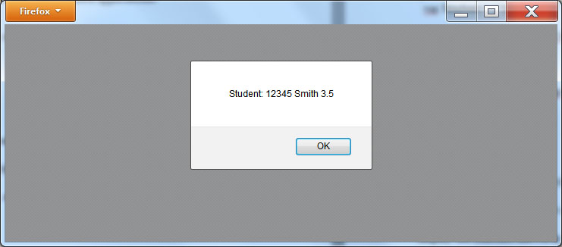
Creating a student object
<!DOCTYPE html> <html> <head> <script> function ShowStudent() { var Student = {"StudentID" : "12345", "Name" : "Smith", "GPA" : "3.5" }; alert("Student: " + Student.StudentID + " " + Student.Name + " " + Student.GPA); } </script> </head> <body onload="ShowStudent()"> </body> </html>

Slide 5
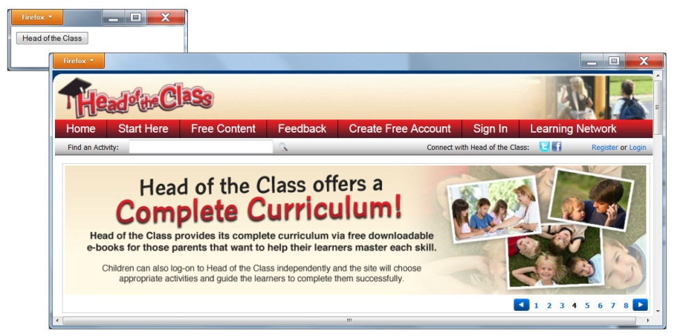
Web site object creation
<!DOCTYPE html> <html> <head> <script> var WebSite = { "Name" : "Head of the Class", "URL" : "http://www.theHeadoftheclass.com" }; function InitButton() { document.getElementById("WebButton").innerHTML = WebSite.Name; } function OpenSite() { window.open(WebSite.URL); } </script> </head> <body onload="InitButton()"> <button id="WebButton" onclick="OpenSite()"></button> </body> </html>

Slide 6
Creating an array of objects
var Companies = [{ "Name" : "Microsoft", "Founder" : "Gates and Allen", "Headquarters" : "Redmond, WA" }, { "Name" : "Facebook", "Founder" : "Zuckerberg", "Headquarters" : "Palo Alto, CA" }, { "Name" : "Oracle", "Founder" : "Ellison", "Headquarters" : "Redwood Shores, CA" }];

Slide 7
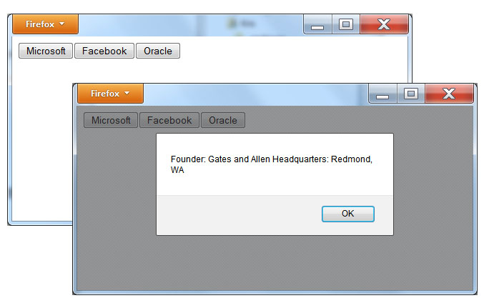
Displaying an array of json objects
<!DOCTYPE html> <html> <head> <script> var Companies = [{ "Name" : "Microsoft", "Founder" : "Gates and Allen", "Headquarters" : "Redmond, WA" }, { "Name" : "Facebook", "Founder" : "Zuckerberg", "Headquarters" : "Palo Alto, CA" }, { "Name" : "Oracle", "Founder" : "Ellison", "Headquarters" : "Redwood Shores, CA" }]; function InitButtons() { var i; var currentHTML; for (i = 0; i < Companies.length; i++) { currentHTML = document.getElementById("thePage").innerHTML; document.getElementById("thePage").innerHTML = currentHTML + "<button onclick='ShowCompany(" + i + ")'>" + Companies[i].Name + "</button>"; } } function ShowCompany(i) { alert("Founder: " + Companies[i].Founder + " Headquarters: " + Companies[i].Headquarters); } </script> </head> <body id="thePage" onload="InitButtons()"> </body> </html>

Slide 8
Real World: Json quotes--retrieving a JSON file
<!DOCTYPE html> <html> <head> <script> var xmlhttp; var Quotes; function loadJSON() { xmlhttp = new XMLHttpRequest(); xmlhttp.onreadystatechange = HandleData; xmlhttp.open("GET","http://www.websitedevelopmentbook.com/Chapter14/Quotes.txt", true); xmlhttp.send(); } function HandleData() { if (xmlhttp.readyState==4 && xmlhttp.status==200) { Quotes = eval('(' + xmlhttp.responseText + ')'); InitButtons(); } }

Slide 9
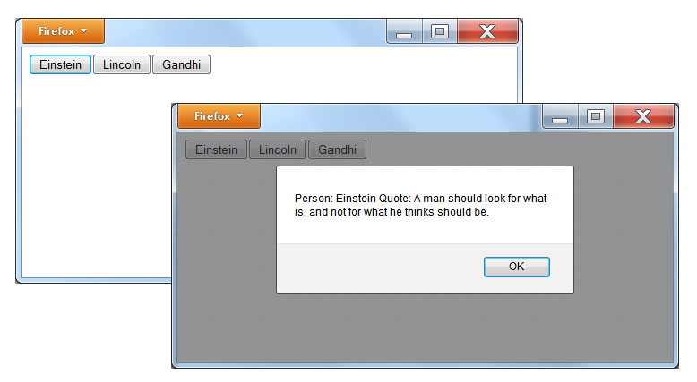
Json quotes continued
function InitButtons() { var i; var currentHTML; for (i = 0; i < Quotes.Messages.length; i++) { currentHTML = document.getElementById("thePage").innerHTML; document.getElementById("thePage").innerHTML = currentHTML + "<button onclick='ShowQuote(" + i + ")'>" + Quotes.Messages[i].Name + "</button>"; } } function ShowQuote(i) { alert("Person: " + Quotes.Messages[i].Name + " Quote: " + Quotes.Messages[i].Quote); } </script> </head> <body id="thePage" onload="loadJSON();"> </body> </html>

Slide 10
summary
Using tools such as AJAX and Websockets, sites can query servers for specific data.
Normally, servers respond to such queries by providing data in XML format.
In this chapter, you learned to use the JSON data format. As you learned, JSON is very similar to JavaScript and easy for your programs to integrate.

